Slide 1
Car Service
Advanced Software Programming - ITMD 515
Group 15
Sathwick Boregowda (A20389100) Sandeep Jagadeesh (A20394821)

Slide 2
Project Outlook
Car service application supports a variety of services involving request car services like :
Buy/Sell Car Service
Mechanic Service.

Slide 3
Project Description
Once the User logs into his account with our Car Service Website, he/she will find 2 services such as Buy/Sell Car based on the model and price & car maintenance such as Break Oil change, Replace Air Filters, Clutch inspection etc.

Slide 4
Technologies and Frameworks used :
Languages/Framework used: JAVA, JSP, JPA, Servlets, JDBC, CSS
Tools/IDE used: NetBeans, GlassFish
Database used: MySQL

Slide 5
Project WorkFlow
Completes the request for services
User
Logs in
Chooses the Services he/she wishes for
Logs out

Slide 6
Sample Screenshots

Slide 7
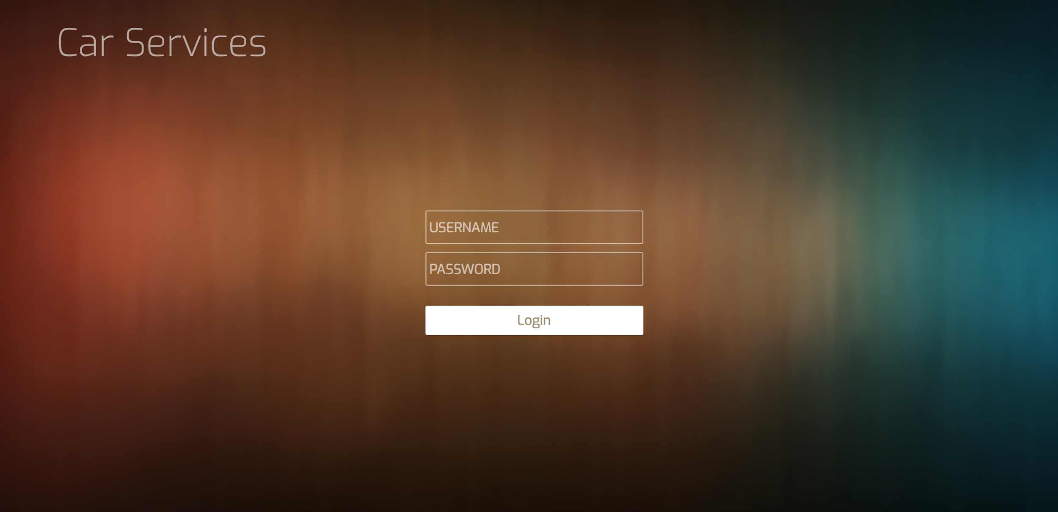
Screenshot - 01
Login page

Slide 8
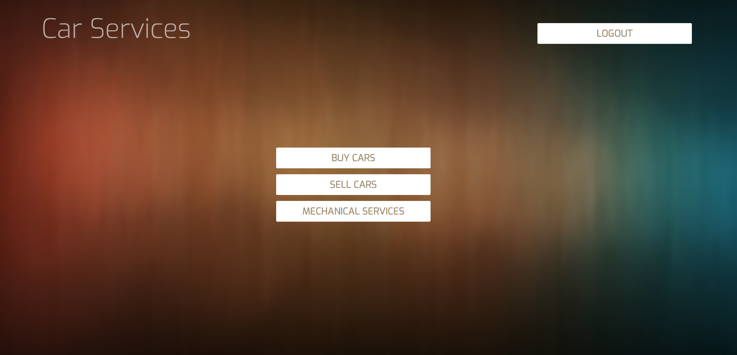
Screenshot - 02
Services Page

Slide 9
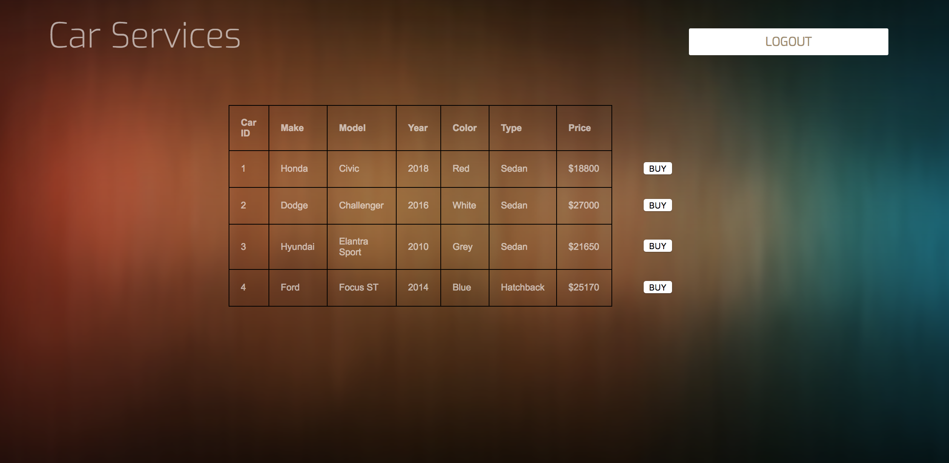
Screenshot 03
List of cars available to buy

Slide 10
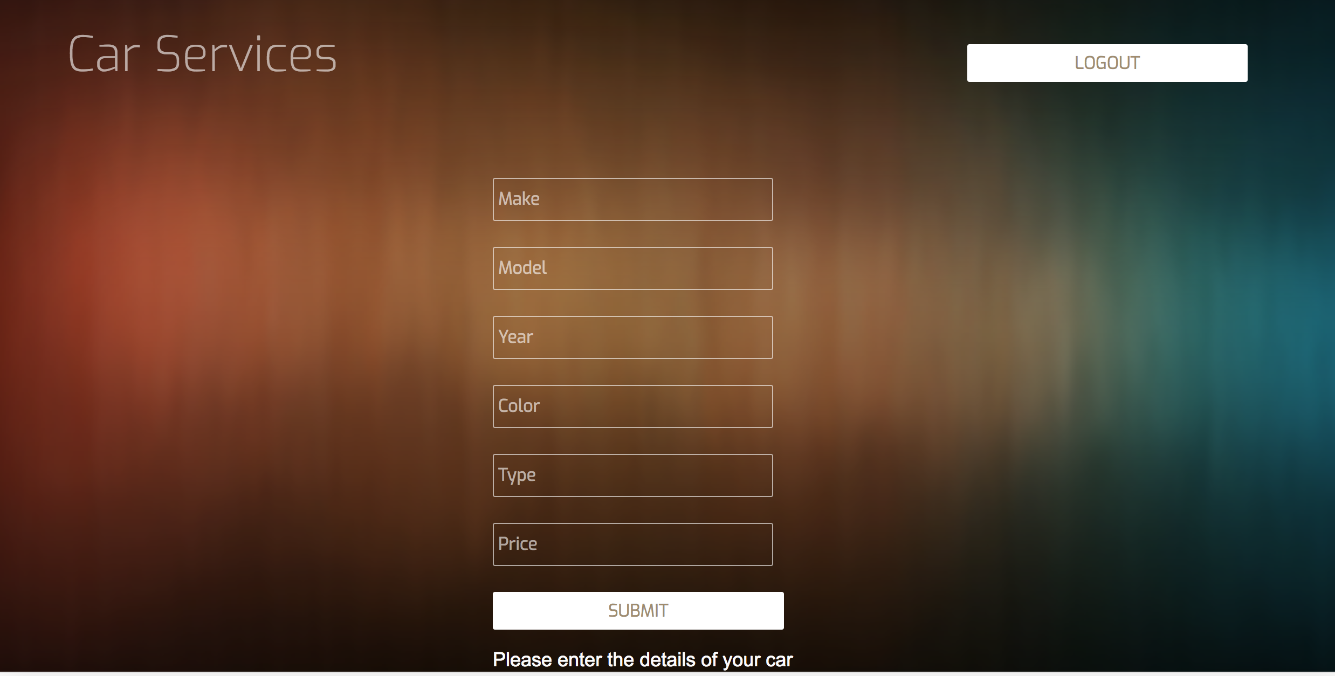
Screenshot 04
Option to Sell Cars

Slide 11
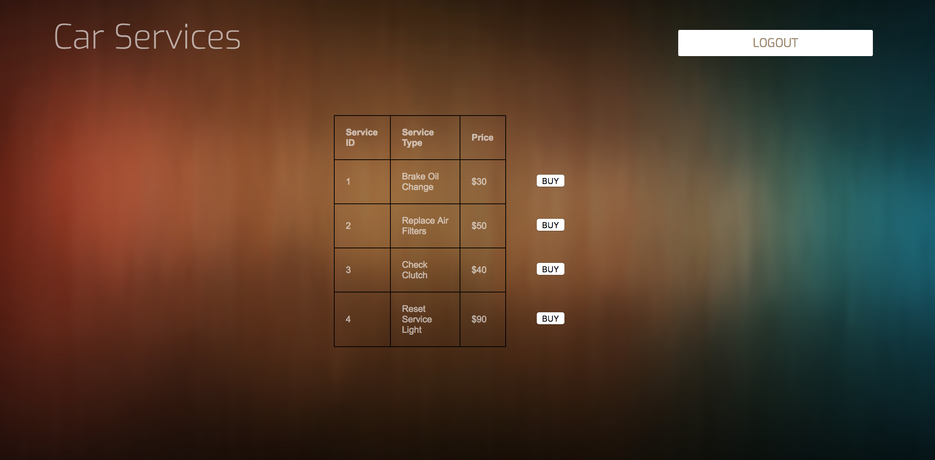
Screenshot 05
List of Mechanical Services

